Slide 1
Link State Routing

Slide 2
Protocol maintains complete road map of the network in each router running a link state routing protocol.
The node can use Dijkstra’s Algorithm to build routing table.
Look at the following slide - each node uses the same topology to create a routing table.

Slide 3
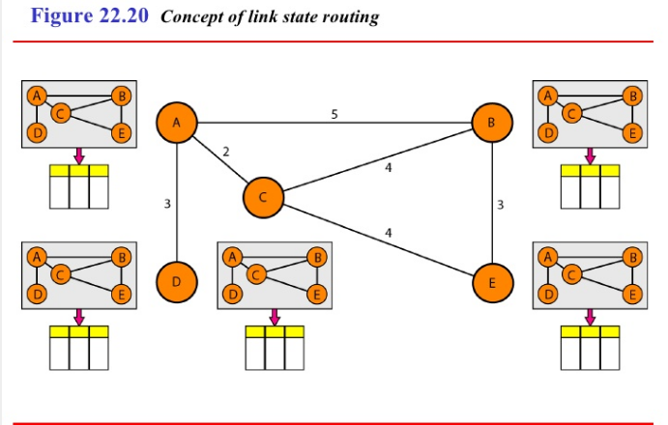

Slide 4
The topology must be dynamic, representing the latest state of each node and each link.
If there are changes in any point in the network, the topology must be updated for each node.
No node can know the topology at the beginning or after a change somewhere in the network.
Link state routing is based on the assumption that, although the global knowledge about the topology is not clear, each node has a partial knowledge - (type, condition and cost) - of its link.
Next figure indicate the part of the knowledge belonging to each node.

Slide 5
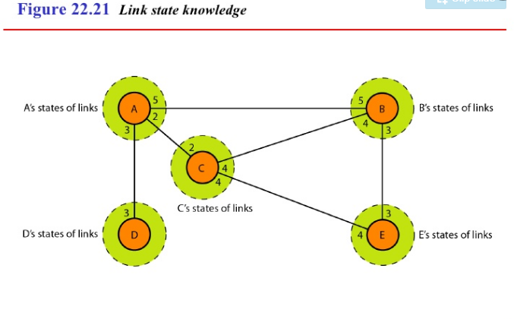

Slide 6
Building routing table
4 set of actions are required to ensure that each node has the routing table showing the least–cost node to every other node.
Creation of the states of the links by each node, called Link state packet (LSP).
Dissemination of LSPs to every other node, called flooding.
Formation of shortest path tree for each node.
Calculation of a routing table based on the shortest path tree.

Slide 7
1. Creation of Link State Packet (LSP)
A LSP can carry a large amount of information.
Like node id, the list of links, a sequence number, age.
First two are needed to make the topology.
Sequence number - facilitates flooding and distinguishes the new LSPs from old ones.
Age - prevents old LSPs from remaining in the domain for a long time.
LSPs are generated on two occasions:
When there is a change in the topology of the domain.
On a periodic basis.

Slide 8
2. Flooding of LSPs
After a node has prepared an LSP, it must be disseminated to all other nodes, not only its neighbors. The process is called flooding.
Steps:
The creating node sends a copy of the LSP out of each interface.
A node that receives an LSP compares it with the copy it may already have.
If arrived LSP is older than the one it has (by checking the sequence no), it discards the packet.
If it is newer:
Discards the old one and keep the new one.
It sends a copy of it out of each interface except the one from which the packet arrived.

Slide 9
3. Formation of shortest path tree
After receiving all LSPs, each node will have a copy of the whole topology.
This is not sufficient to find the shortest path to every other node.
A shortest path tree is needed.
The Dijkstra’s algorithm creates a shortest path tree from a graph.
The algorithm divides the node into two sets: tentative and permanent.
It finds the neighbors of a current node, makes them tentative, examines them, if passes criteria - makes them permanent.

Slide 10
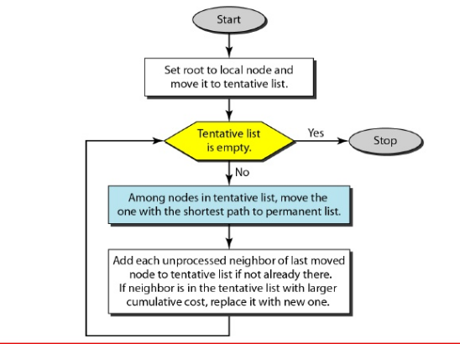
Dijkstra’s algorithm

Slide 11
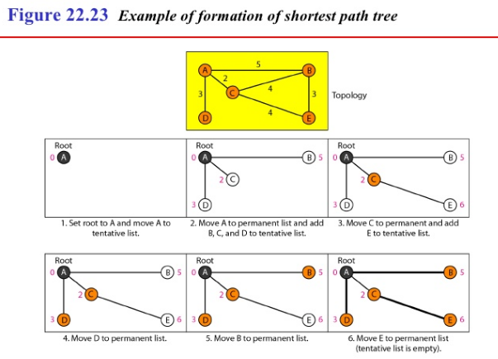
a

Slide 12
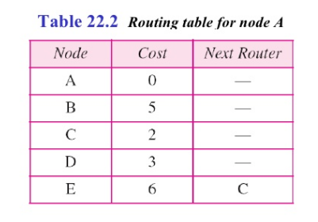
4. Calculation of routing table from Shortest Path tree
Each node uses the shortest path tree protocol to construct its routing table.
The routing table shows the cost of reaching each node from the root.

Slide 13
OSPF

Slide 14
OSPF
OSPF Open Shortest Path First is a link-state routing protocol that was developed in 1991.
It is an intradomain routing protocol based on link-state routing.
OSPF was a replacement for distance vector routing protocol RIP.
Based on Bellman-Ford Algorithm.
Worked well in small systems.

Slide 15
Areas
An OSPF network can be divided into sub-domains called areas.
An area is a logical collection of OSPF networks, routers, and links that have the same area identification.
Areas limit the scope of route information distribution. It is not possible to do route update filtering within an area.

Slide 16
The main benefit of creating areas is a reduction in the number of routes to propagate—by the filtering and the summarization of routes.
Areas are identified by an area ID.
All network inside an area must be connected.
At the border of an area, special router called area border routers.
It summarizes the information and send to other areas.

Slide 17
Backbone Area
A backbone area—which combines a set of independent areas into a single domain.
The backbone has the reserved area ID of 0.0.0.0. The OSPF backbone area is also known as area 0.
The backbone acts as a hub for inter-area transit traffic and the distribution of routing information between areas.
Each non-backbone area must be directly connected to the backbone area.
The backbone area must not be partitioned—divided into smaller pieces—under any failure conditions.

Slide 18
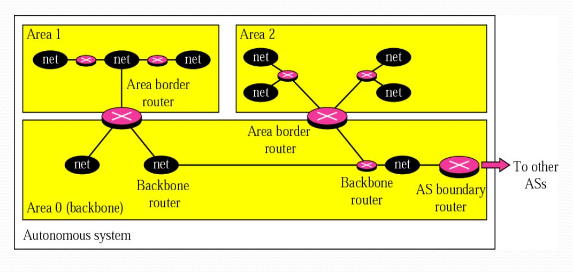
The backbone serves as primary area and the other areas as secondary areas.
The router inside backbone area is known as backbone routers.

Slide 19
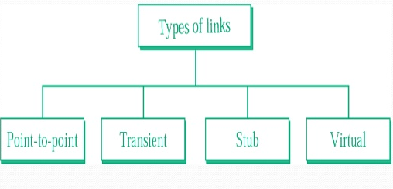
Types of Links
In OSPF, a connection is called a link.
4 types of links have been defined:

Slide 20
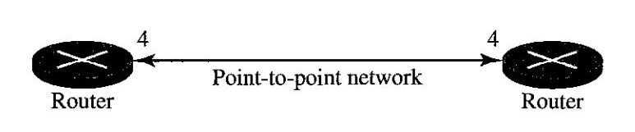
Point-to-Point Link
A point-to-point link is a dedicated link that connects exactly 2 communication facilities.
It connects 2 routers without any other host or router in between.
E.g.: Telephone line.
No need to assign a network address to this type of link.
Router – Nodes.
Link – Bidirectional Edge.

Slide 21
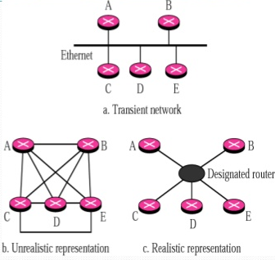
Transient Link
Several routers attached to it.
Data can enter or leave through any router.
Each router has many neighbors.

Slide 22
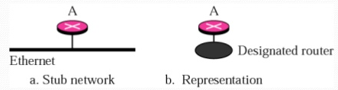
Stub Link
Connected to only 1 router.
Data enters and leaves through this single router.
Only 1 direction.

Slide 23
Virtual Link
When link between 2 routers are broken, the administrator creates a virtual link between them.
Using a longer path, which passes through several routers.

Slide 24
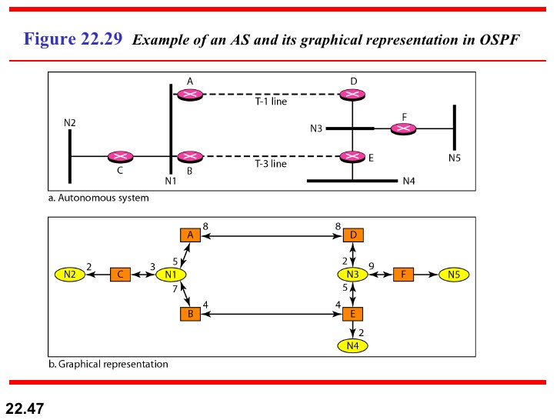
Graphical representation of AS

Slide 25
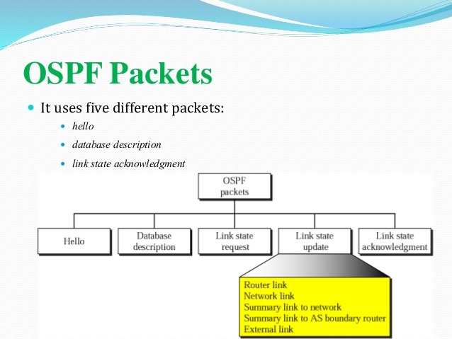
OSPF Packets
It uses 5 different packets:
Hello
Database description
Link state request
Link state update
Link state acknowledgement

Slide 26
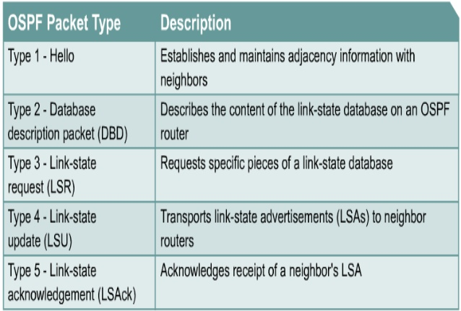

Slide 27
